Slide 1
MECH 5970/6970
Lecture 2 on Vision-based Navigation and Guidance
Sridhar Lakshmanan
Electrical & Computer Engineering
University of Michigan-Dearborn
Email: Lakshman@umich.edu

Slide 2
Fundamentals of vision-based navigation
Identify fixed points in the world over two successive image frames
Correspondence problem ← Did this in the first lecture→Quick review
Estimate the camera’s translation and rotation from these points
Inverse problem

Slide 3

Inverse problem: 3D geometry
ASSUMPTIONS
We assume that all I points are co-planar, but not co-linear
π denotes the plane the points lie in (reference plane)
n(t) is the unit vector normal to π in the direction of Fc
d(t) is the distance between π and Fc along n(t)
H(t₁) is the so-called homography matrix at time t₁
$$[$$

Slide 4
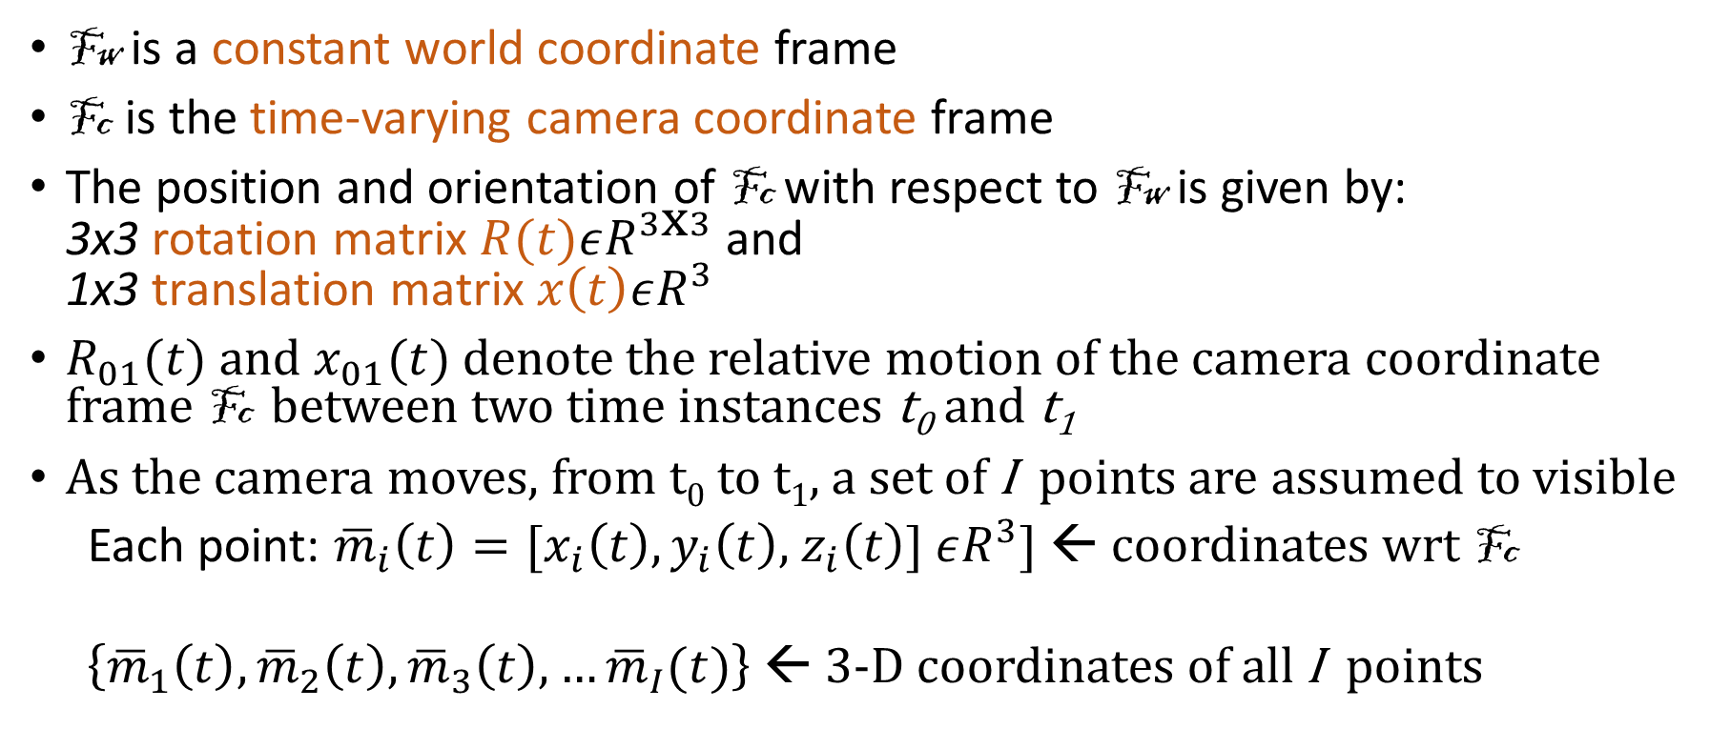
Notation
Fw is a constant world coordinate frame
Fc is the time-varying camera coordinate frame
The position and orientation of Fc with respect to Fw is given by: 3x3 rotation matrix $R(t)εR^{3\text{x} 3}$ and 1x3 translation matrix $x\left(t\right)εR^{3}$
$R_{01}(t)$ and $x_{01}(t)$ denote the relative motion of the camera coordinate frame Fc between two time instances t₀ and t₁
As the camera moves, from t₀ to t₁, a set of I points are assumed to visible
Each point: ${\overline{m}}_{i}\left(t\right)=[x_{i}\left(t\right),y_{i}\left(t\right)$, $z_{i}\left(t\right)]$ $εR^{3}$] ← coordinates wrt Fc
$\left\{{\overline{m}}_{1}\left(t\right),{\overline{m}}_{2}\left(t\right),{\overline{m}}_{3}\left(t\right),…{\overline{m}}_{I}(t)\right\}$ ← 3-D coordinates of all I points

Slide 5

Inverse problem in 2D
${\{p_{i}εR^{3}: p}_{i}(t$) = [$u_{i}(t$), $v_{i}(t$), 1] = A . m_{i}(t), i=1,2,…I}
are the pixel coordinates of I the visible points on π
Known
Is the projection of ${\overline{m}}_{i}\left(t\right)$ onto the image-pixel coordinate axis
Known

Slide 6





Matrix algebra essentials
$$εR^{N}$$
$$εR^{M}$$
$$εR^{M}$$
$$G_{MN}$$
$$εR^{N}$$

Slide 7
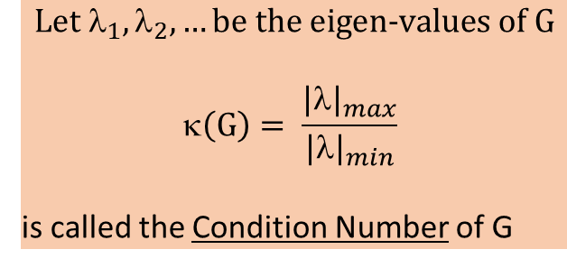

Square matrices
$$G_{MM}$$
u
If $_{1},_{2}, …$ are distinct ≠0, then eigen-vectors $\left\{{\underline{e}}_{1},{\underline{e}}_{2}, …,{\underline{e}}_{M}\right\}$span R^{M}
$$\text{Let} λ_{1},λ_{2}, …\text{be} \text{the} \text{eigen}\text{−}\text{values} \text{of} \text{G}$$
$$\left(\text{G}\right)= \frac{{|λ|}_{max}}{{|λ|}_{min}}$$
is called the Condition Number of G

Slide 8

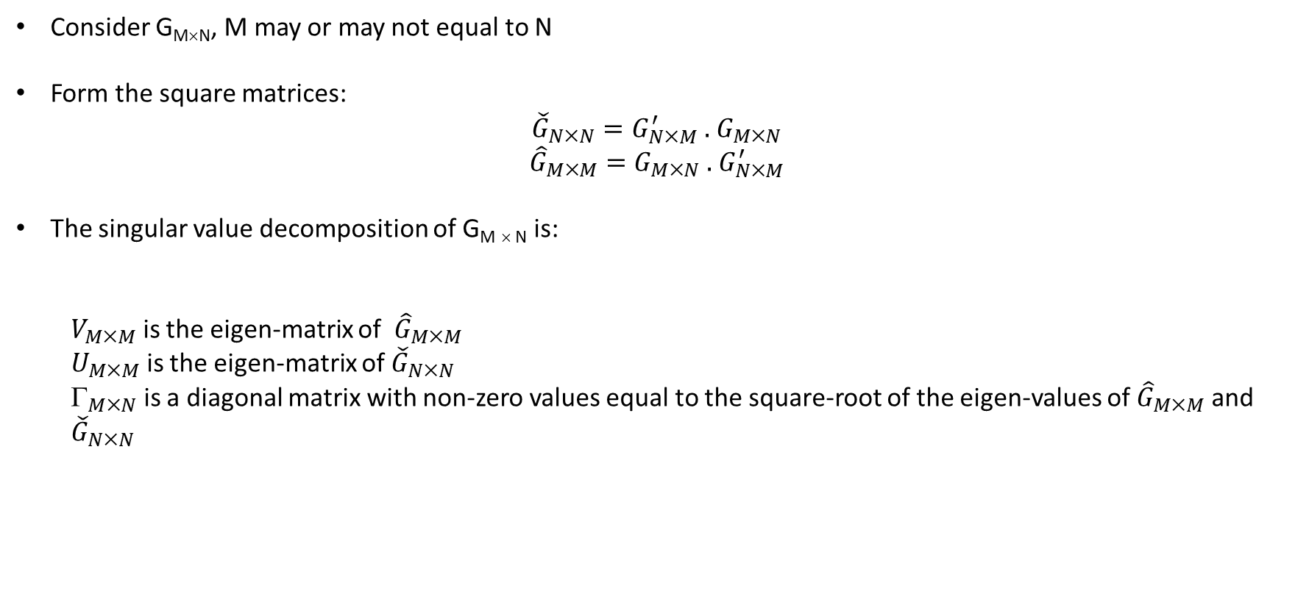

General singular-value decomposition
Consider G_{M×N}, M may or may not equal to N
Form the square matrices:
$${\check{G}}_{N×N}={G_{N×M}^{′} \text{.} G}_{M×N}$$
$${\hat{G}}_{M×M}=G_{M×N} \text{.} G_{N×M}^{′}$$
The singular value decomposition of G_{M} $$_{N} is:
$V_{MM}$ is the eigen-matrix of ${\hat{G}}_{M×M}$
$U_{MM}$ is the eigen-matrix of ${\check{G}}_{N×N}$
$_{MN}$ is a diagonal matrix with non-zero values equal to the square-root of the eigen-values of ${\hat{G}}_{M×M}$ and ${\check{G}}_{N×N}$
$G_{MN}=$ $V_{MM}{_{MN}U}_{NN}^{′}$
The Condition Number of G $\left(\text{G}\right)= \frac{{|λ|}_{max}≥0}{{|λ|}_{min}≥0}$ where the $$’s come from $$

Slide 9












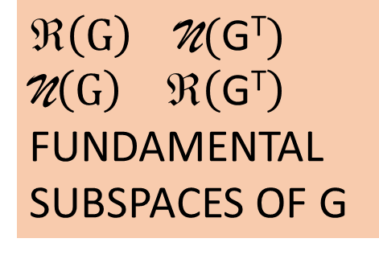






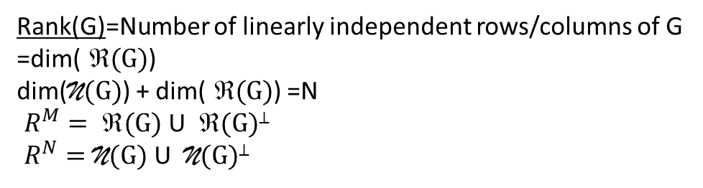







All kinds of spaces relating to matrix G
$$R^{M}$$
G
$$R^{N}$$
$$R^{M}$$
G^{T}
$$R^{N}$$
$$ (G) \text{Range}$$
$$ (\text{G}\text{T})$$
$${ R}^{M}$$
$$ \underline{u}$$
$$ \underline{ν}$$
$$ \underline{u}$$
$$ \underline{ν}$$
$$ $$
$$\text{D}\left(\text{G}\text{T} \right)$$
$$ $$
$${ R}^{M}$$
$\text{D}\left(G\right)$Domain
Rank(G)=Number of linearly independent rows/columns of G
=dim($ (G)$)
dim($\text{N}(G)$) + dim($ (G)$) =N
$ R^{M}= (G)$ U $ (G)$⊥
$ R^{N}=\text{N}(G)$ U $ \text{N}(G)$⊥
Rank($\text{G}\text{T}$) = dim($ (\text{G}\text{T})$)
dim($\text{N}(\text{G}\text{T})$) + dim($ (\text{G}\text{T})$) =N
$R^{N}= ℜ(\text{G}\text{T})$ U $ (\text{G}\text{T})$⊥
$ R^{M}=\text{N}(\text{G}\text{T})$ U $ \text{N}(\text{G}\text{T})$⊥
$$\left(G\right) \text{N}(\text{G}\text{T})$$
$\text{N}\left(G\right) ℜ\left(\text{G}\text{T}\right)$
FUNDAMENTAL SUBSPACES OF G
G
$$R^{M}$$
$$R^{N}$$
G^{T}
$$R^{M}$$
$$R^{N}$$
$$0$$
$$0$$
$$0$$
$$0$$
$\text{N}(G)$ Nullspace
$$\text{N}(GT)$$

Slide 10
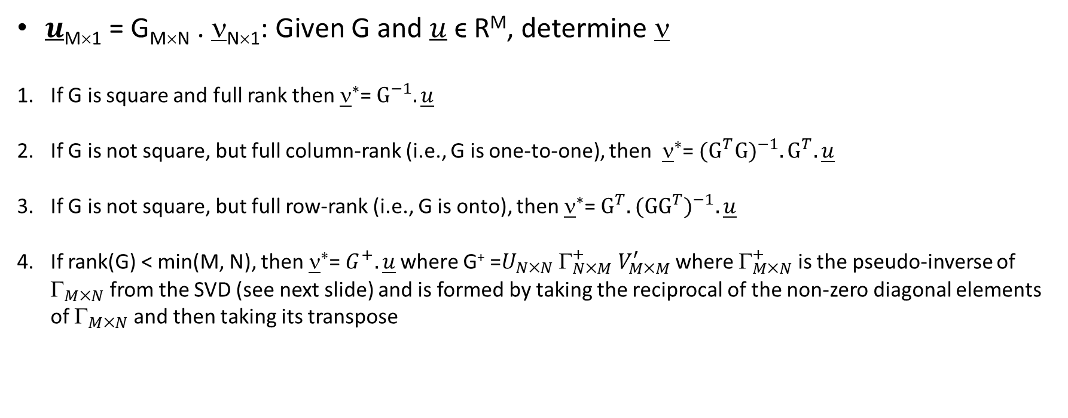
Inverse problem
$u$_{M×1} = G_{M×N} . $$_{N×1}: Given G and $u$ ϵ R^{M}, determine $$
If G is square and full rank then ${\underline{ν}}^{∗}$= ${\text{G}}^{−1}. \underline{u}$
If G is not square, but full column-rank (i.e., G is one-to-one), then ${\underline{ν}}^{∗}$= ${({\text{G}}^{T}\text{G})}^{−1}. {\text{G}}^{T}.\underline{u}$
If G is not square, but full row-rank (i.e., G is onto), then ${\underline{ν}}^{∗}$= ${{\text{G}}^{T}.(\text{G}{\text{G}}^{T})}^{−1}.\underline{u}$
If rank(G) < min(M, N), then ${\underline{ν}}^{∗}$=${ G}^{+}.\underline{u}$ where G⁺ =$U_{NN} _{NM}^{+} V_{MM}^{′}$ where $_{MN}^{+}$ is the pseudo-inverse of $_{MN}$ from the SVD (see next slide) and is formed by taking the reciprocal of the non-zero diagonal elements of $_{MN}$ and then taking its transpose

Slide 11
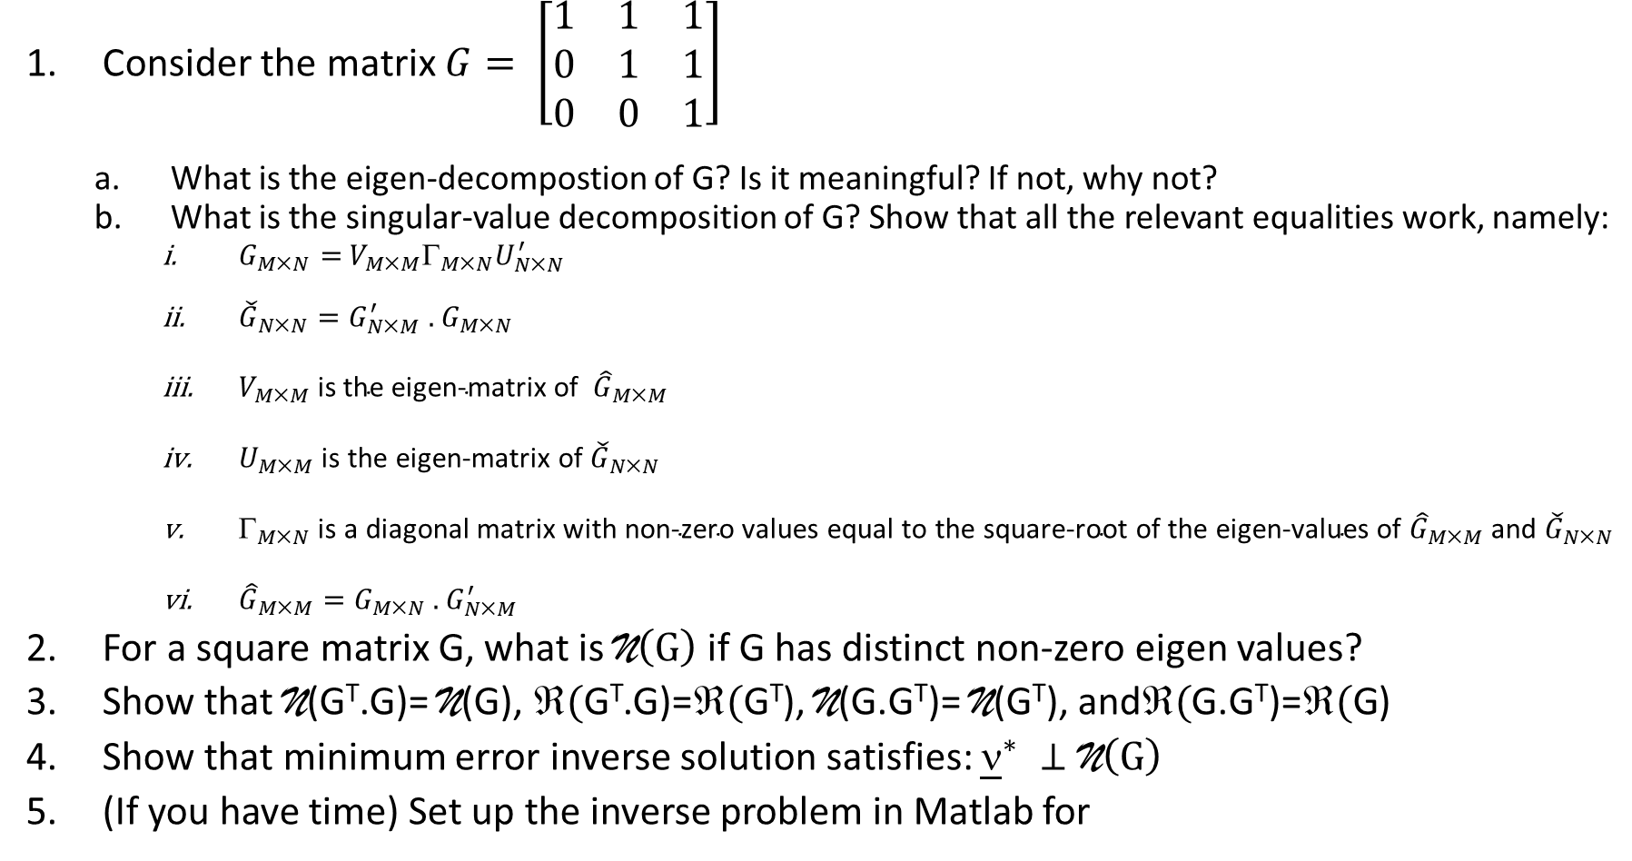
Homework
Consider the matrix $G= \left[\begin{matrix}1 & 1 & 1 \\ 0 & 1 & 1 \\ 0 & 0 & 1\end{matrix}\right]$
What is the eigen-decompostion of G? Is it meaningful? If not, why not?
What is the singular-value decomposition of G? Show that all the relevant equalities work, namely:
$G_{MN}=$ $V_{MM}{_{MN}U}_{NN}^{′}$
${\check{G}}_{N×N}={G_{N×M}^{′} \text{.} G}_{M×N}$
$V_{M×M} \text{is} \text{the} \text{eigen}\text{-}\text{matrix} \text{of} {\hat{G}}_{M×M}$
$U_{M×M} \text{is} \text{the} \text{eigen}\text{-}\text{matrix} \text{of} {\check{G}}_{N×N}$
$_{M×N} \text{is} \text{a} \text{diagonal} \text{matrix} \text{with} \text{non}\text{-}\text{zero} \text{values} \text{equal} \text{to} \text{the} \text{square}\text{-}\text{root} \text{of} \text{the} \text{eigen}\text{-}\text{values} \text{of} {\hat{G}}_{M×M} \text{and} {\check{G}}_{N×N}$
${\hat{G}}_{M×M}=G_{M×N} \text{.} G_{N×M}^{′}$
For a square matrix G, what is $\text{N}\left(G\right)$ if G has distinct non-zero eigen values?
Show that $\text{N}$($\text{G}\text{T}$.G)= $\text{N}$(G), $\text{(}\text{G}\text{T}$.G)=$\text{(}\text{G}\text{T}$), $\text{N}$(G.$\text{G}\text{T}$)= $\text{N}$($\text{G}\text{T}$), and$\text{(}$G.$\text{G}\text{T}$)=$\text{(}\text{G}$)
Show that minimum error inverse solution satisfies: ${\underline{ν}}^{∗} ⊥\text{N}\left(G\right)$
(If you have time) Set up the inverse problem in Matlab for

